Slide 1

The Rise of MOOCs
Past Successes, Future Challenges
Stephen Downes
Tunis, March 24, 2014
http://www.downes.ca/presentation/337

Slide 2
World-Renowned Competencies
Advanced Analytics & Machine Reasoning
Individualized Learning Technologies
GaN Technologies & Devices
Advanced Photonic Communications Technologies
Printable Electronics
Analytical Techniques and Materials Characterization
Advanced Photonic Components
Optical Testing
Semiconductor Foundry Services
Gallium Nitride Electronics
NRC ICT
Portfolio
Functional Materials
Learning and Collaborative Technologies
Functional Devices
Cognitive Modelling
Functional Imprinting
Machine-Based
Learning/Reasoning
Data and Text Mining
Statistical-Based Machine Translation
Decision Support Systems
Human-Computer Interface Usability
Natural Language Processing
3D Interactive Visualization
Notes:
Our clients and partners tap into our extensive pool of highly sought-after technical experts, researchers, business specialists, software designers, programmers, and engineers in the fields of novel electronic and photonic devices, prototype development, advanced analytics and machine reasoning, and individualized learning technologies.
We are a multidisciplinary organization that can link ICT activities to other key sectors including aerospace, construction, surface transportation, energy, agriculture, and security and disruptive technologies, as you need. The broad spectrum of disciplines across NRC can help move technologies forward, and the exchange of ideas among areas of research within the same organization allows for rapid technological advancements in new and exciting sectors.
We are here to provide you with technology solutions for the following market segments:
Advance photonic communication technologies to support the exponentially growing global demand for telecommunication services.
GaN technologies and devices for the next generation of RF power transistor technology that offers higher power, higher efficiency and wider bandwidth than today’s solutions.
Printable Electronics solutions enable lower-cost digital manufacturing of ubiquitous electronic devices, transforming industries and creating new markets.
Advanced analytics and machine reasoning for long-term cost-effective solution in the area of data analytics.
Individualized learning technologies for reduced-cost training, knowledge and learning management.

Slide 3


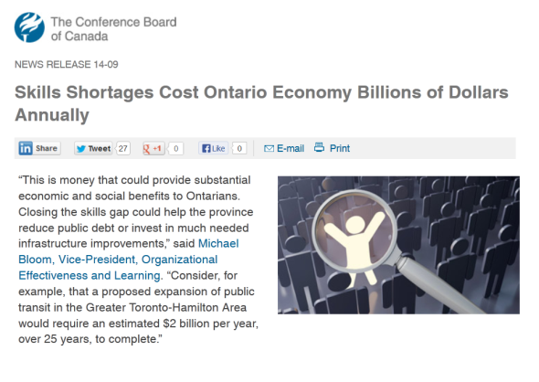



The Skills Shortage
August 26, 2013
Notes:
We already said that Skills shortages are costly to the economy
And, Formal modes of education and training can’t keep pace with the changing environment: what we learn is not valuable as long
There are several means, training is one of them.
Shrinking half-life of knowledge (basically, what we learn is not valuable as long)
Formal modes of education and training have not adapted
Plus, traditional platforms focus on the organizations using them.
And they are based on the one size fits all mentality (just like traditional education)
They are shifting their view, mostly because of their markets becoming saturated, but they still have unresolved issues.
There are other ways of addressing the problem
Like bringing skilled people in from other provinces, other countries
We don’t believe this is a long term solution
But, one of the ways is to provide the means to more efficiently ‘skill’ people.
Through adapting to the user, not forcing the user to adapt to a ‘course’ or ‘program’ or whatever. Yes, initial education and skilling is important. But lifelong learning needs better tools.

Slide 4
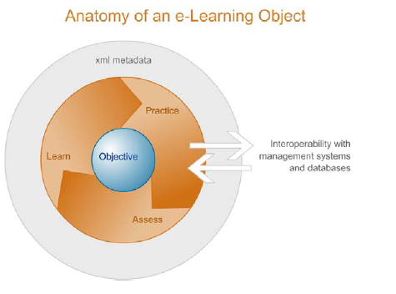
Learning Objects
Learning Objects: Resources For Distance Education Worldwide
http://www.irrodl.org/index.php/irrodl/article/view/32
http://download.macromedia.com/pub/solutions/downloads/elearning/elusive_vision.pdf page 4

Slide 5
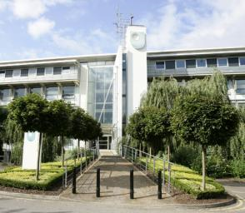
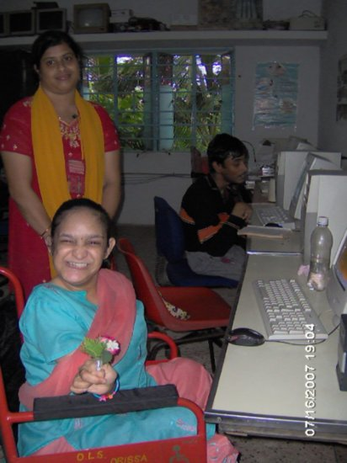
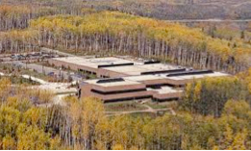
The Idea of Open Learning...
http://www.open.ac.uk/
http://www.open.edu.au/
इंदिरा गाँधी राष्ट्रीय मुक्त विश्वविद्यालय
http://www.ignou.ac.in/
http://www.athabascau.ca/

Slide 6
Open Educational Resources
  'teaching, learning and research materials
  any medium, digital or otherwise
  reside in the public domain or have been released under an open license
  no-cost access, use, adaptation and redistribution by others with no or limited restrictions.
Notes:
REL…
J'expliquerai d'abord de ce que j'entends par MOOC et j'élaborerai davantage sur la pédagogie d'un MOOC. Je parlerai ensuite des résultats d'un MOOC et de l'objectif d'offrir ou de suivre un MOOC. Puis, j'aborderai le lien entre le MOOC et la communauté, pour finalement faire quelques observations et offrir quelques exemples pour démontrer comment les MOOC peuvent promouvoir la diversité linguistique et culturelle.

Slide 7
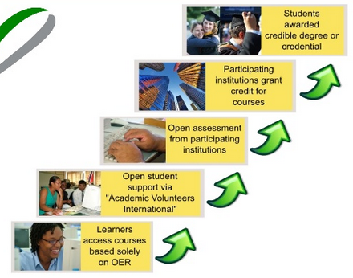

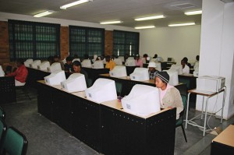
The OERu ‘Logic Model’
http://www.slideshare.net/mackiwg/oeru2011-11meetinginputs

Slide 8
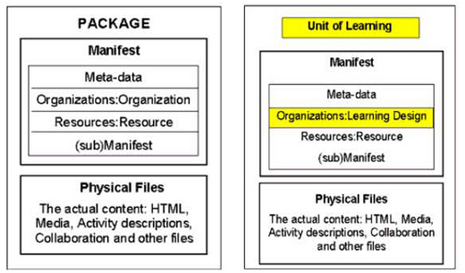
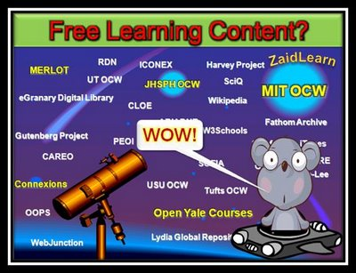
Open Educational Resources
Phase 1
http://zaidlearn.blogspot.com/2008/06/university-learning-ocw-oer-free.html
http://www.imsglobal.org/metadata/
http://ltsc.ieee.org/wg12/files/LOM_1484_12_1_v1_Final_Draft.pdf
http://creativecommons.org/

Slide 9
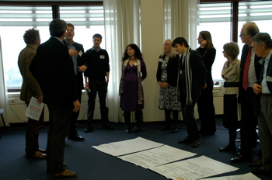
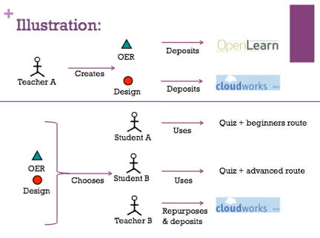
Learning Design & Open Practices
Phase 2
http://www.educause.edu/Resources/BeyondOERShiftingFocustoOpenEd/224619
http://opal.innovationpros.net/news/launch-of-tools-to-enable-open-educational-practices/
...the Open Educational Practices movement, developed by Germany's Ulf-Daniel Ehlers and the UK's Gráinne Conole...
http://e4innovation.com/?p=373

Slide 10
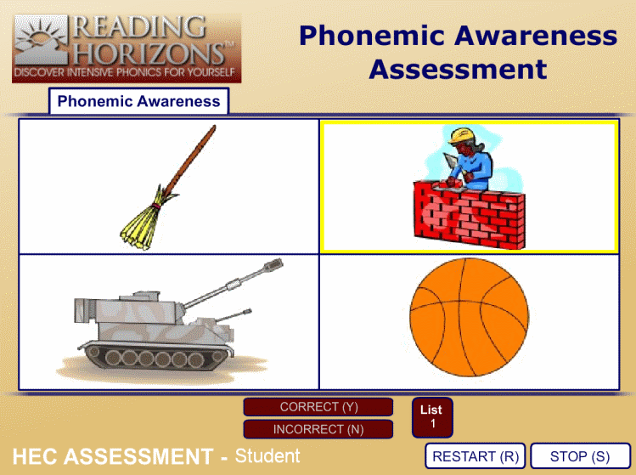
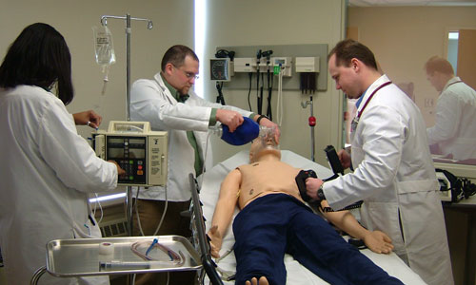

Open Credentials
Phase 3
http://www.brainbench.com/
http://www.aspirationtech.org/events/p2pu/openassessment/2010

Slide 11
Traditional Course
In the traditional course, we just throw content at people, and hope it sticks.
Traditional
Course
Website
Most online courses are based on content-based websites (even Coursera, Khan and Udemy)

Slide 12
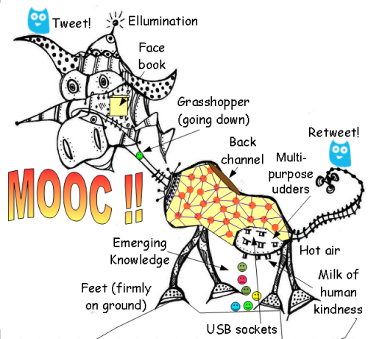
The MOOC
Massive – by design
Open – gratis and libre
Online – not blended, not wrapped
Courses – not communities, websites, video collections, etc
Image: Gordon Lockhart
http://gbl55.wordpress.com/2011/03/08/cck11-man-this-mooc-is-something-else/

Slide 13
Massive Open Online Course
Site
A MOOC is a Web, not a Website

Slide 14

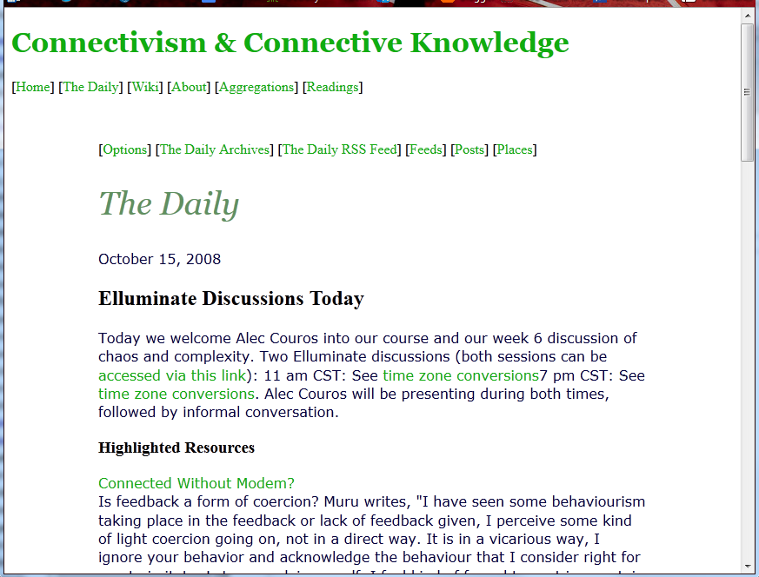
CCK08
http://wwwapps.cc.umanitoba.ca/moodle/course/view.php?id=20
2300 students
http://connect.downes.ca/cgi-bin/archive.cgi?page=thedaily.htm

Slide 15
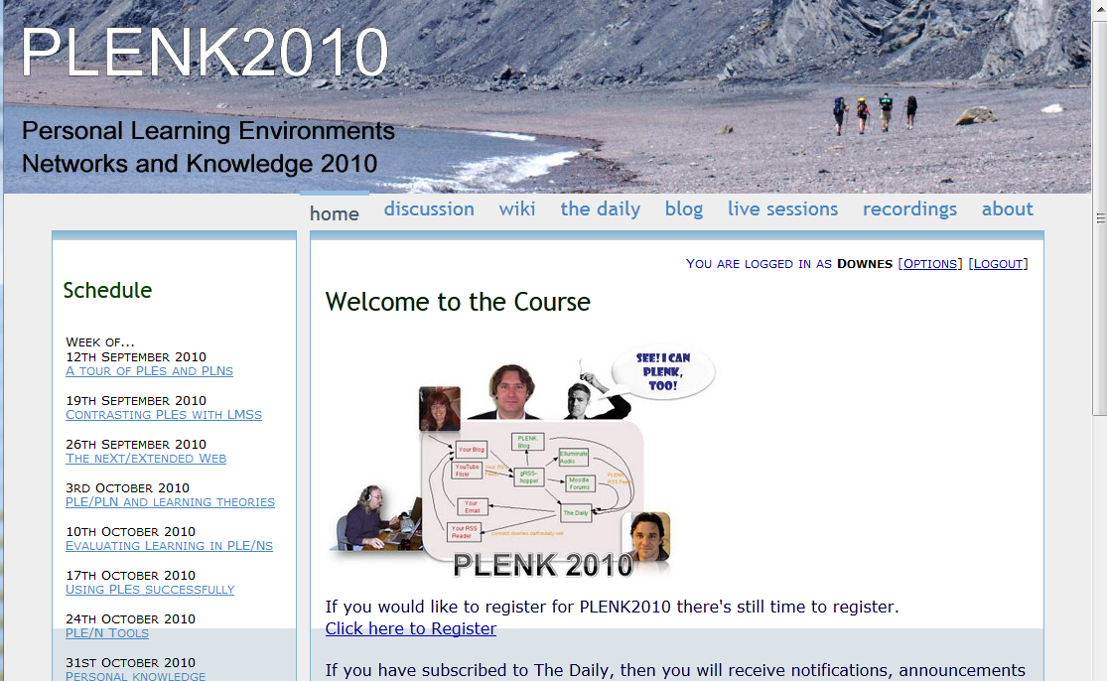
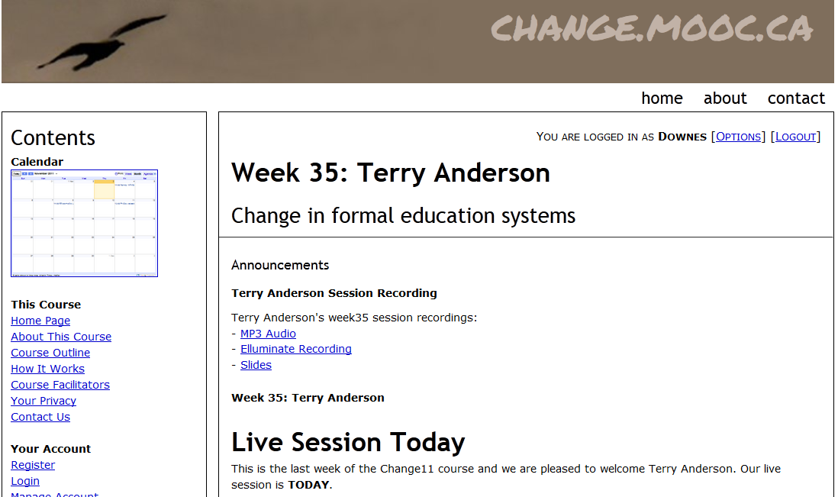

Other Courses
1800 students
http://connect.downes.ca/
2800 students
3000 students
http://change.mooc.ca/
http://edfuture.net/

Slide 16
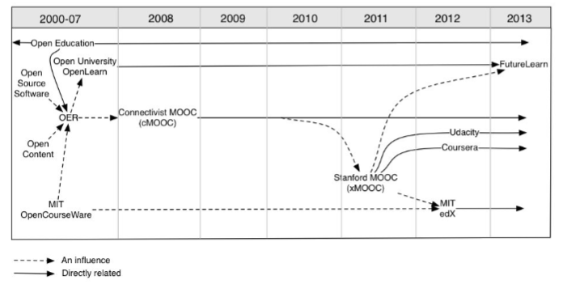
Evolution of MOOCs
http://publications.cetis.ac.uk/wp-content/uploads/2013/03/MOOCs-and-Open-Education.pdf

Slide 17
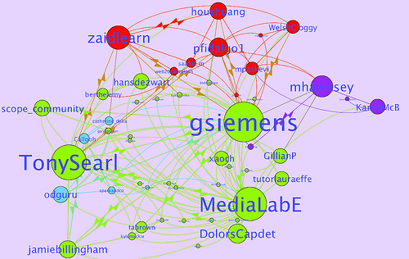
Learning Analytics
LAK11: How to measure success in a MOOC
http://scope.bccampus.ca/course/view.php?id=365

Slide 18
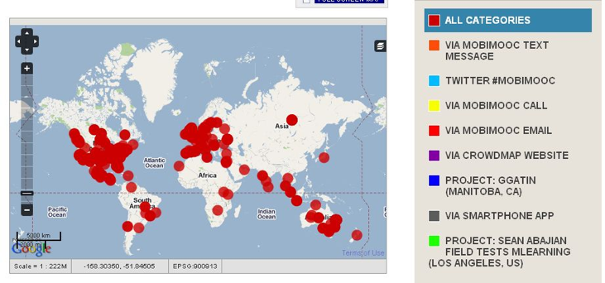
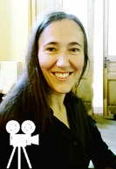
MobiMOOC
Inge de Waard
Supporting Mobile Learning Technology
http://mobimooc.wikispaces.com/

Slide 19
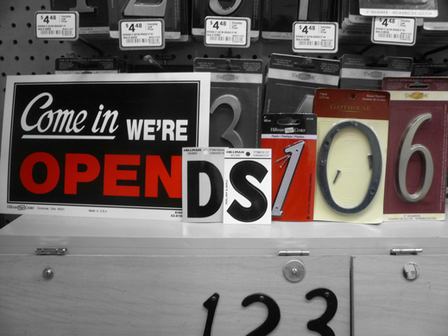

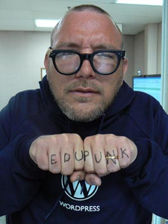

The madness and mayhem of DS106
Jim Groom
DS = Digital Storytelling
DS106 redefined activities and participation
http://ds106.us/

Slide 20
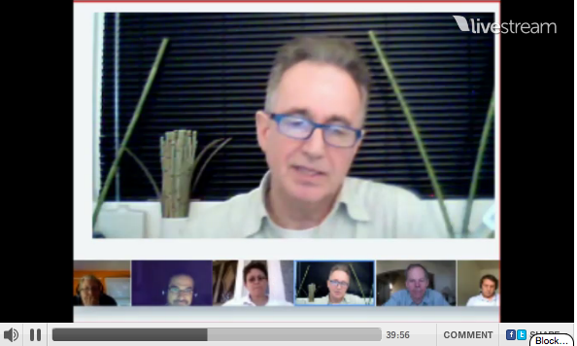

eduMOOC underground
Jeff Lebow
Jeff Lebow, Google+ hangout, and Livestream:
Taking something ordinary, and making it something special – YOU make the MOOC
http://www.livestream.com/jefflebow/

Slide 21
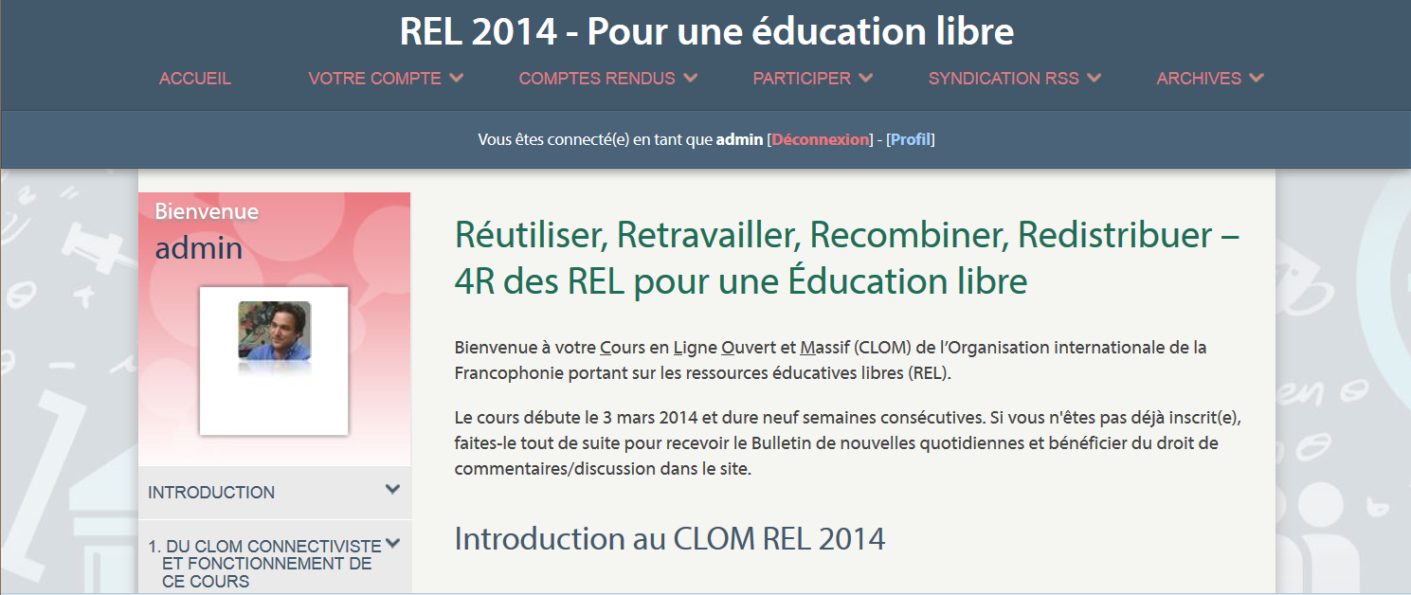
Currently
MOOC REL 2014
http://rel2014.mooc.ca

Slide 22
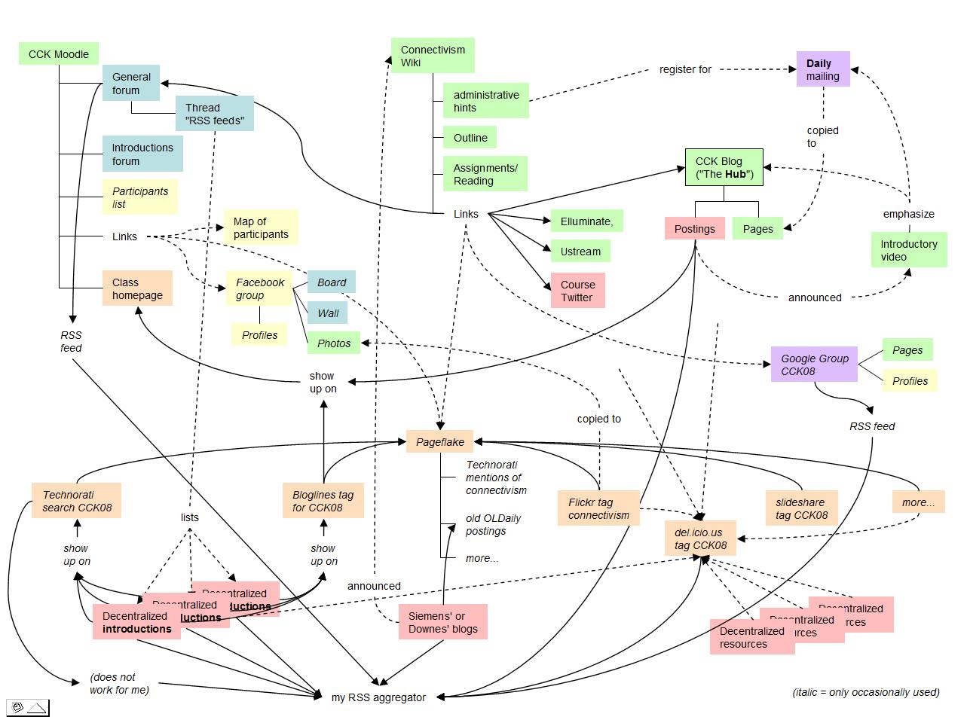
Connectivist MOOCs
http://x28newblog.blog.uni-heidelberg.de/2008/09/06/cck08-first-impressions/

Slide 23

















Course Provider Perspective
Subscribed
students
Student
content
Site
Course
content
Live online events
Event recordings

Slide 24
Underlying MOOC Support
1. First student creates resource and sends info to course
Site
2. Second student sees resource info in newsletter and RSS feed
3. Second student accesses the resource directly
4. Second student finds link to third student’s resource

Slide 25
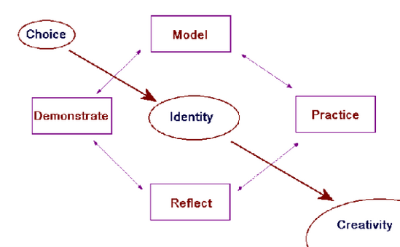
Pedagogical Models
Instructivist – knowledge as transmission
Discovery – knowledge as experience
Constructivist – knowledge as representation
Connectivist – knowledge as recognition
http://www.downes.ca/presentation/146

Slide 26
Connectivist Learning Design
A non-curricular based approach
  course content is the ‘McGuffin’ vs (Freire) the ‘banking system’
  learning takes places through interaction and creativity
    Seymour Papert – constructionism
    Aggregate, remix, repurpose, feed forward
Learning a matter of growth, not accumulation

Slide 27
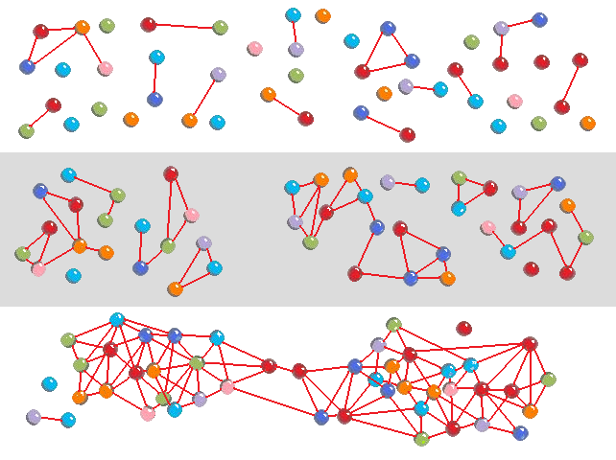
Self-Organizing networks
These are at once perceptual systems and reasoning systems

Slide 28

Design Principles
Autonomy
- Choice of contents
- Personal learning
- No curriculum
Openness
- Open access
- Open content
- Open activities
- Open assessment
Diversity
- Multiple tools
- Individual perspective
- Varied content
Interactivity
- Encourage communication
- Cooperative learning
- Emergent knowledge

Slide 29
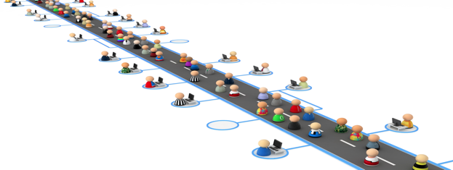
A Note on Sustainability
Ongoing costs for development, cloud hosting, software
Of course, whatever we really want is sustainable
Like, say, highways

Slide 30
Sustaining OERs
Redirection of existing resource allocations
  eg. OA mandates for grants and programs
  community outreach for existing agencies
    eg, NASA
Support for community-based OER process
  integration of OER development and use within publicly supported curricula
  use of OERs in public services and programs
- Stephen Downes, Models for sustainable Open Educational Rsources, ijklo.org/Volume3/IJKLOv3p029-044Downes.pdf http://www.downes.ca/presentation/76
- OER Help with Keynote Slides, OER-Forum http://lists.esn.org.za/pipermail/oer-forum/2011-October/thread.html

Slide 31
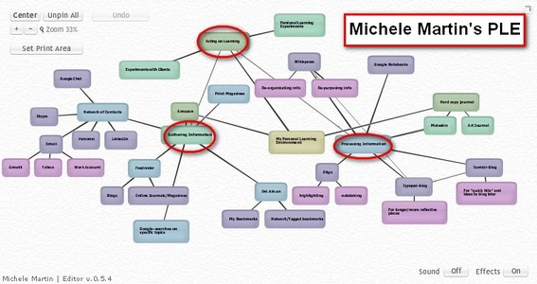
Personal Learning
http://www.downes.ca/post/58150
http://dmlcentral.net/blog/howard-rheingold/diy-u-interview-anya-kamenetz
Notes:
Howard Rheingold searches for the new in Anya Kamenetz's Edupunk's Guide, suggesting that what has been added is the idea of the personal learning plan to the personal learning network. "Making a public commitment to something is going to increase your accountability," says Kamenetz. Rheingold writes, "Her work serves as a bridge between blended learning and peeragogy. I previously wrote about Shelly Terrell and personal learning networks" and asks here what it takes for a group to self-organize. Kamanetz responds that there needs to be a common understanding of the goal - of course, this would be the outcome of self-organization, not what makes it possible.

Slide 32
The Student’s Perspective
Site
A range of different resources and services

Slide 33

LPSS program
Personal Learning and Performance
Support
Single point of access to all skills development and training needs
Individual learning path
Context-aware support
Searchable and verifiable
Tailored to industry needs
Always available

Slide 34
LPSS Program Overview
LPSS is a $19 million program over 5 years, average 30 FTEs per year
Based on hosted services used to develop and monetize core technologies, which are then transferred to commercial receptors
Will work with Canadian learning technology providers and target verticals to address critical skills shortages in that industry
Revenues during program execution, with potential for ongoing licensing revenues

Slide 35
Learning and Performance Support System:
Core Technology Development Projects
Resource Network
Learning Assistant
Automate Skills Dev.
Personal Learning Records
Learning services network and marketplace
Automated skills development and recognition
Lifetime management of learning and training records and credentials
Personal learning assistant to view, update and access training
Learning as a cloud service and deep integration with external systems
Notes:
the solution would consist of the main components as shown on the slide
Learning as a Cloud Service - will create a distributed learning layer, which is mechanism for working with data no matter where it is stored, through desktop, mobile and other devices.
Resource Repository Network – will create a resource graph from multiple sources and multiple formats including live and dynamic data such as oilfield data, refinery instrumentation, or Oil and Gas market information.
Personal Learning Record - this project will define how we represent, capture, and leverage user activity, including ratings, test results, performance measures, and the like, in a distributed learning and work environment.
Automated Competence Development And Recognition – whereas existing recommender systems depend on manually defined metrics, this system will detect new and emerging competences and automatically assess employee performance.
Personal Learning Assistant – this project will develop an integrated learning appliance, a mechanism for looking up or finding references or resources inside other programs or environments.

Slide 36
Why Is This Difficult?
It’s not one big thing…
… but a set of many small things
Tasks that are simple in an enterprise system…
  Like data storage
  Like content distribution
  Like authentication
  Like analytics
… become that much more difficult

Slide 37
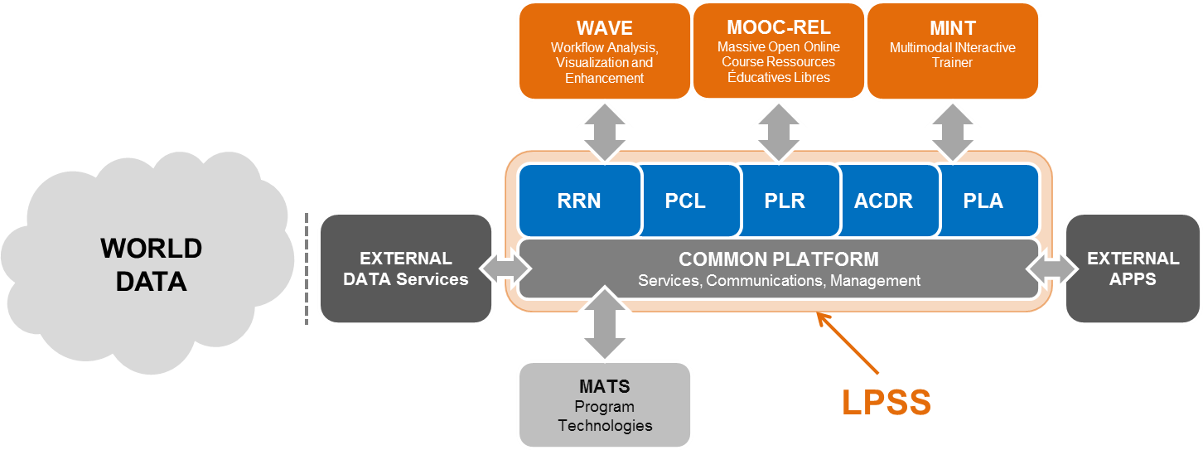
Whaat is LPSS?
It’s a network of personal learning environments…
… connected to a large array of learning services
http://halfanhour.blogspot.com.es/2013/12/learning-and-performance-support-systems.html
http://www.nrc-cnrc.gc.ca/eng/solutions/collaborative/lpss.html

Slide 38
Core Projects, Implementation Projects

Slide 39
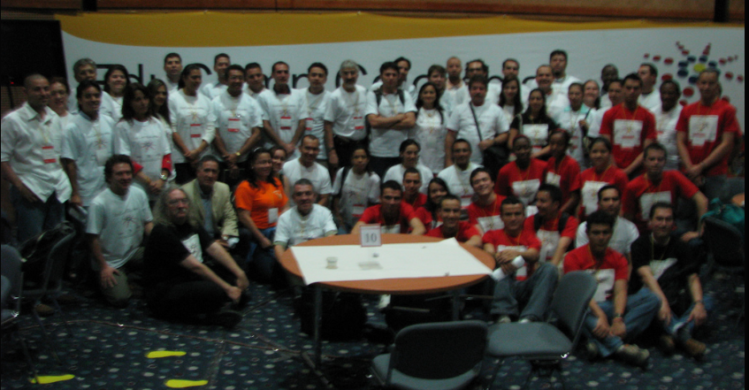
Triad Model
Students, Teachers, Community = presence
Sunshine Project, Slave Lake, Canada http://www.huffingtonpost.com/stephen-downes/the-role-of-the-educator_b_790937.html
Educamp Colombia, Bogota and Medellin http://www.irrodl.org/index.php/irrodl/article/view/884/1677
Jaaga – via EdgeX, India http://jaaga.in/study/

Slide 40
New Roles for Government
Communications and Education Infrastructure
Support for Open Educational Resources
Support for Free Learning
Management of assessments and credentialing

Slide 41
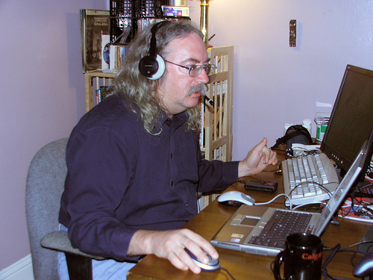
http://www.downes.ca
Stephen Downes
Stephen.Downes@nrc-cnrc.gc.ca

